Slide 1
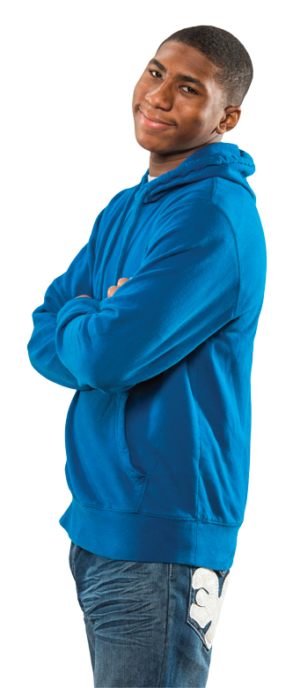
Keeping Parents in the Loop

Slide 2
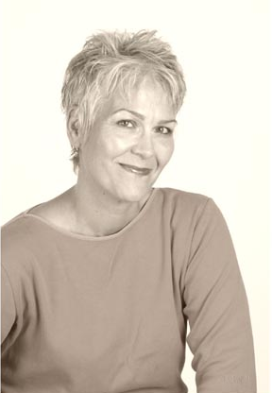
Parents endure while all else changes
Parent in district since 1997 – 16 years
Kids in 3 different schools
Experienced 10-12 different principals and 8 superintendents (including 4 interim)
Julie Schultz Brown
Saint Paul Public Schools

Slide 3
Other SPPS parents
1.8%
31.4%
29.6%
Students speak more than 100 languages and dialects
Approximately 4,000 students are new to SPPS each year, 2,000 at the secondary level
17% of students require special education services
73% of students are eligible for free or reduced-price lunch
Approximately 2,000 students experience homelessness during the school year

Slide 4
Parents key to student stability through change
If parents know what’s going on, less student anxiety
If parents know what’s going on, less staff anxiety
If parents know what’s going on, less school community anxiety

Slide 5
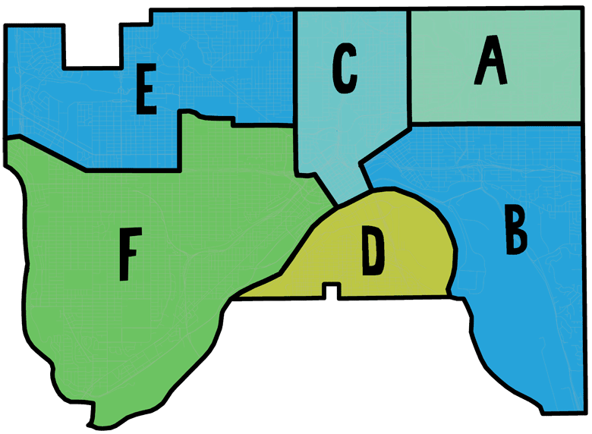
2010 Strong Schools, Strong Communities (SSSC) 3-year Strategic Plan
Reorganizes district into six Areas, and encourages learning closer to home
Still offers choice
Streamlines busing
More focused on equitable resources

Slide 6
Parents as key stakeholders through SSSC transition
Transportation changes mean school changes
New attendance areas change enrollment possibilities
Middle schools replace junior highs

Slide 7
SSSC communications
Make it graphic
Make it simple
Bring it to the school level
Involve friends
Create new info opportunities, but use existing ones, too

Slide 8
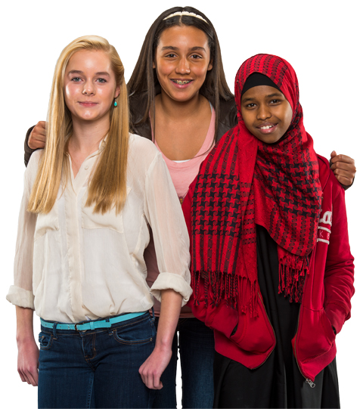
SSSC District-wide Action Teams
Some 200 community members participated
Co-chaired by staff leader and community leader
6-month commitment around 9 topics

Slide 9
One Thing I Love About Saint Paul Public Schools
Campaign created by outside firm; funded by private dollars
Wrapped, signed OTIL school bus featured at kick-off event
OTIL webpage, standards, “swag”
Branded marketing materials delivered at schools
“One Thing I Love’s” replaced Muzak on district phones
Notes:
Links on the slide:
One Thing I Love style guide (http://www.spps.org/uploads/spps_1thingilove_styleguide.pdf)
One Thing I Love kick-off video (http://bit.ly/qKvkAv - Schooltube)

Slide 10
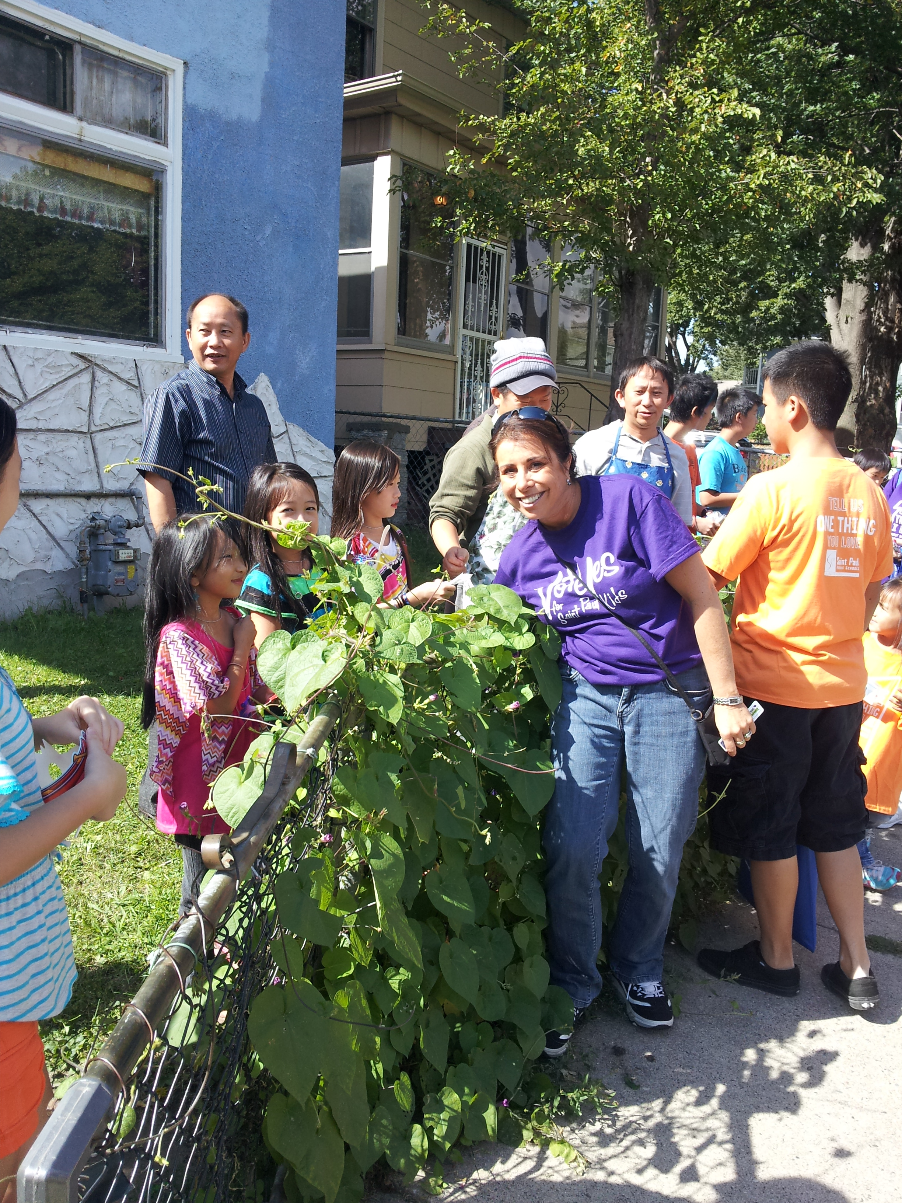
Community outreach
Blanketed community in posters/tear-offs and School Selection Guides
Community enrollment sites
Participation in parades and community festivals
Employee enrollment canvassing
Transition activities at schools this spring
Notes:
Links on this page:
- SPC enrollment poster
School selection guide
Door hanger

Slide 11
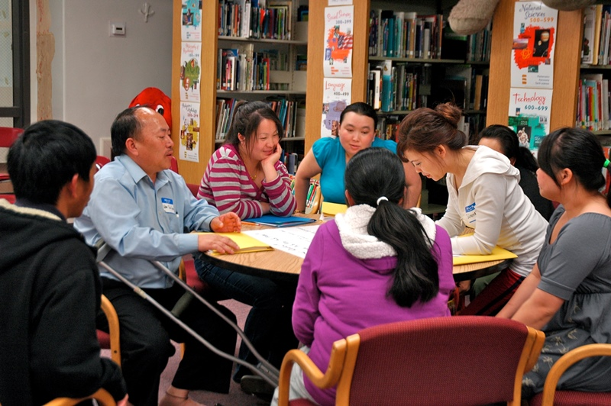
District Parent Advisory Committees
One non-culturally specific committee
Individual committees for Karen, African American, Latino, Somali, and Special Education
Provide food, transportation and childcare

Slide 12
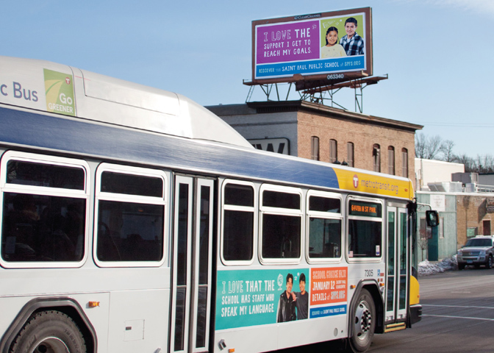
Advertising during school choice season
Played off “One Thing I Love”
Funded through private grant
Billboards, digital boards, bus sides, Google, community newspapers, community radio
Univision segments with superintendent
Notes:
Links on this page:
Haberman wrap-up pdf

Slide 13
Glaring omission – social media
SPPS initiated FB just a year ago
Schools have FB informally
Working to expand our presence to drive website traffic
fb.me/SaintPaulPublicSchools
@SPPS_News | @SPPS_SuptSilva
youtube.com/StPaulPublicSchools

Slide 14
Were we successful?
Enrollment trending up
Achievement trending up
Working hard to be sure parents feel heard

Slide 15
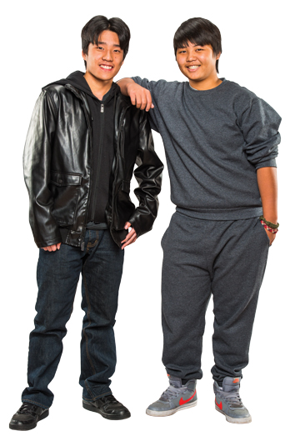
Bottom Line: Parents Can Make It Happen
Initiatives and personnel come and go
Strong programs will endure if parents are informed advocates
Keep your parents in the loop.

Slide 16
For more information
www.spps.org
www.apply.spps.org
Julie Schultz Brown
Director
Communications, Marketing & Development
651.767.8365 (o)
julieschultz.brown@spps.org

